Slide 1
UNIVERSITY INSTITUTE OF ENGINEERING
COMPUTER SCIENCE ENGINEERING
Master of Engineering
ADVANCED DATA STRUCTURES
&
ALGORITHMS
(23CSH-622)
INTRODUCTION
DISCOVER . LEARN . EMPOWER

Slide 2

ADVANCED DATA STRUCTURES
&
ALGORITHMS
(23CSH-622)
By : Dr. Ranjit Singh (E10947)
www. cuchd.in Campus : Gharaun, Mohali

Slide 3
Contents of the Syllabus
UNIT-I (15h)
Introduction to Basic Data Structures: Importance and need of good data structures and algorithms, Introduction to linear and non-linear data structure and its importance, Algorithms Complexity and Analysis. [3]
Linear and Non –Linear Data Structures : Arrays , Link Lists, Queues , Trees and related algorithms [6]
Advanced Data Structures: AVL Trees (Insertion , Deletion , Searching), Red-Black Trees, B-trees, B+trees, Heaps. Data structure for disjoint sets, Augmented data structures. [6]
UNIT-II (15h)
Searching and Sorting : Internal and External Sorting algorithms: Linear Search, Binary Search, Bubble Sort, Selection Sort, Insertion Sort, Shell Sort, Quick Sort, Heap Sort, Merge Sort, Counting Sort, Radix Sort and analysis of their complexities and Hashing [4]
Graphs & Algorithms: Representation, Type of Graphs, Depth- and breadth-first traversals, Planar graphs, isomorphism, graph coloring, covering and partition, Minimum Spanning Tree: Prim’s and Kruskal’s algorithms. [6]
String Matching Algorithms: Naïve String Matching, Suffix arrays, Suffix trees, Rabin-Karp, Knuth-Morris-Pratt, Booyer-Moore algorithm [5]

Slide 4
Contents of the Syllabus
UNIT-III (15h)
Approximation algorithms: Need of approximation algorithms: Introduction to P, NP, NP-Hard and NP-Complete Greedy Approach, Dynamic Approach, Knapsack, Huffman Coding, TSP, All pair shortest path, Longest Common Subsequence Problem, Matrix Chain Multiplication. [7]
Randomized algorithms: Introduction, type of randomized algorithms, Quick sort, min cut [4]
Online Algorithms: Introduction, Online Paging Problem, k-server Problem. Data compression: Huffman’s coding, BWT, LZW [4]
Recommended Books:
1. Cormen, Leiserson, Rivest, Stein, “Introduction to Algorithms”, Prentice Hall of India, 3rd edition 2012.
2. Horowitz, Sahni and Rajasekaran, “Fundamental of Computer, Algorithms”, University Press (India), 2nd edition.
3. Aho, Haperoft and Ullman, “The Design and analysis of Computer Algorithms”, Pearson Education India.

Slide 5
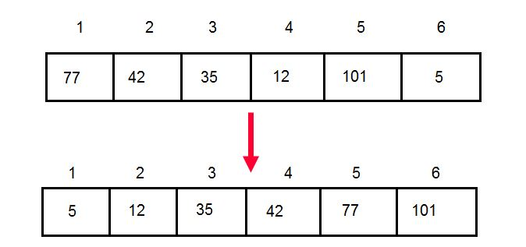
Sorting
Sorting is a process in which records are arranged in ascending or descending order
Types Of Sorting
Bubble sort
Insertion sort
Selection sort
Merge sort
Quick sort
Heap sort
Shell sort
Cycle sort
Count sort
Radix Sort

Slide 6
Bubble Sort
Exchange two adjacent elements if they are out of order. Repeat until array is sorted.
Example:
Take an array of numbers " 5 1 4 2 8", and sort the array from lowest
number to greatest number using bubble sort. In each step, elements
written in bold are being compared. Three passes will be required;

Slide 7
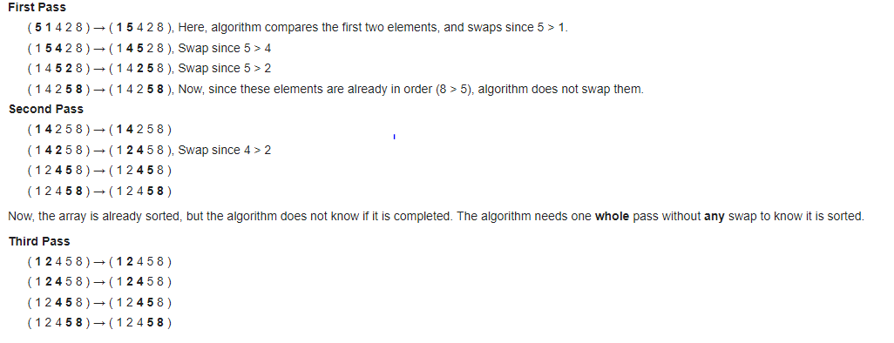
Step-by-step example

Slide 8
Bubble Sort
BUBBLE(DATA, N)
Here DATA is an array with N elements. This algorithm sorts the elements in DATA.
Repeat steps 2 and 3 for K = 1 to N – 1
Set PTR = 1 [Initialize pass pointer PTR]
Repeat while PTR ≤ N – K [Executes pass]
If DATA[PTR] > DATA[PTR + 1], then
Interchange DATA[PTR] and DATA[PTR + 1]
[End of If structure]
Set PTR = PTR + 1
[End of inner loop]
[End of step 1 outer loop]
Exit

Slide 9
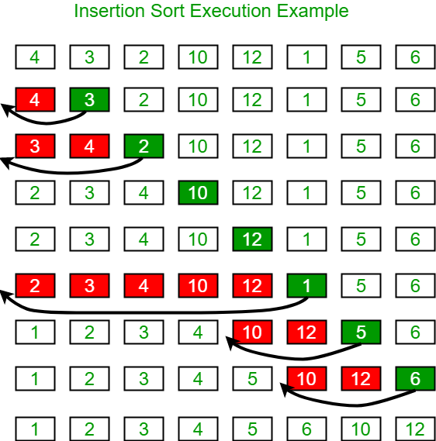
Insertion sort
Insertion sort is a simple sorting algorithm that works the way we sort playing cards in our hands

Slide 10
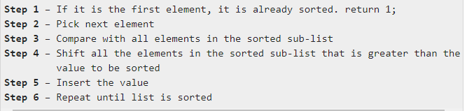
Algorithm

Slide 11
Selection Sort
Selection sort is a simple sorting algorithm. This sorting algorithm is an in-place comparison-based algorithm in which the list is divided into two parts, the sorted part at the left end and the unsorted part at the right end. Initially, the sorted part is empty and the unsorted part is the entire list.
The smallest element is selected from the unsorted array and swapped with the leftmost element, and that element becomes a part of the sorted array. This process continues moving unsorted array boundary by one element to the right.
This algorithm is not suitable for large data sets as its average and worst case complexities are of Ο(n²), where n is the number of items.

Slide 12
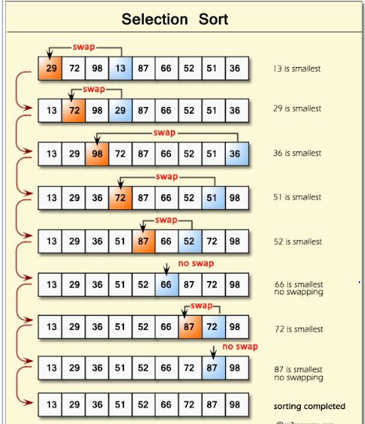
Example

Slide 13
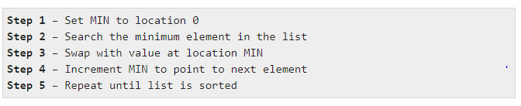
Algorithm

Slide 14
Heap Sort
Heap sort is one of the sorting algorithms used to arrange a list of elements in order.
Heapsort algorithm uses one of the tree concepts called Heap Tree.
In this sorting algorithm, we use Max Heap to arrange list of elements in descending order and Min Heap to arrange list elements in ascending order.
Step 1 - Construct a Binary Tree with given list of Elements.
Step 2 - Transform the Binary Tree into Max Heap.
Step 3 - Delete the root element from Max Heap using Heapify method.
Step 4 - Put the deleted element into the Sorted list.
Step 5 - Repeat the same until Min Heap becomes empty.
Step 6 - Display the sorted list.

Slide 15
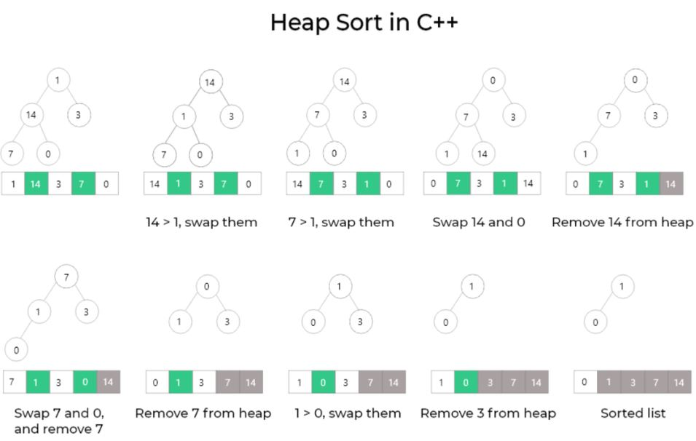

Slide 16
Merge Sort
Divide and Conquer
Divide and Conquer cuts the problem in half each time, but uses the result of both halves:
cut the problem in half until the problem is trivial
solve for both halves
combine the solutions
A divide-and-conquer algorithm:
Divide the unsorted array into 2 halves until the sub-arrays only contain one element
Merge the sub-problem solutions together:
Compare the sub-array’s first elements
Remove the smallest element and put it into the result array
Continue the process until all elements have been put into the result array

Slide 17
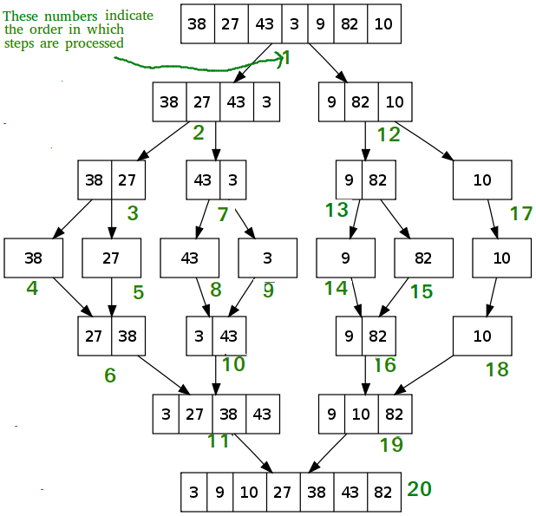

Slide 18
Algorithm
MergeSort(arr[], l, r)
If r > l
1. Find the middle point to divide the array into two
halves:
middle m = (l+r)/2
2. Call mergeSort for first half:
Call mergeSort(arr, l, m)
3. Call mergeSort for second half:
Call mergeSort(arr, m+1, r)
4. Merge the two halves sorted in step 2 and 3:
Call merge(arr, l, m, r)

Slide 19
Quick Sort
Divide: In Divide, first pick a pivot element. After that, partition or rearrange the array into two sub-arrays such that each element in the left sub-array is less than or equal to the pivot element and each element in the right sub-array is larger than the pivot element.
Conquer: Recursively, sort two subarrays with Quicksort.
Combine: Combine the already sorted array.

Slide 20
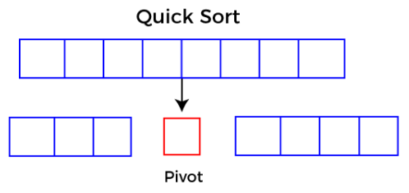
Quick Sort
Quicksort picks an element as pivot, and then it partitions the given array around the picked pivot element. In quick sort, a large array is divided into two arrays in which one holds values that are smaller than the specified value (Pivot), and another array holds the values that are greater than the pivot.
After that, left and right sub-arrays are also partitioned using the same approach. It will continue until the single element remains in the sub-array.

Slide 21
Quick Sort
Choosing the pivot
Picking a good pivot is necessary for the fast implementation of quicksort. However, it is typical to determine a good pivot. Some of the ways of choosing a pivot are as follows –
Pivot can be random, i.e. select the random pivot from the given array.
Pivot can either be the rightmost element of the leftmost element of the given array.
Select median as the pivot element.

Slide 22
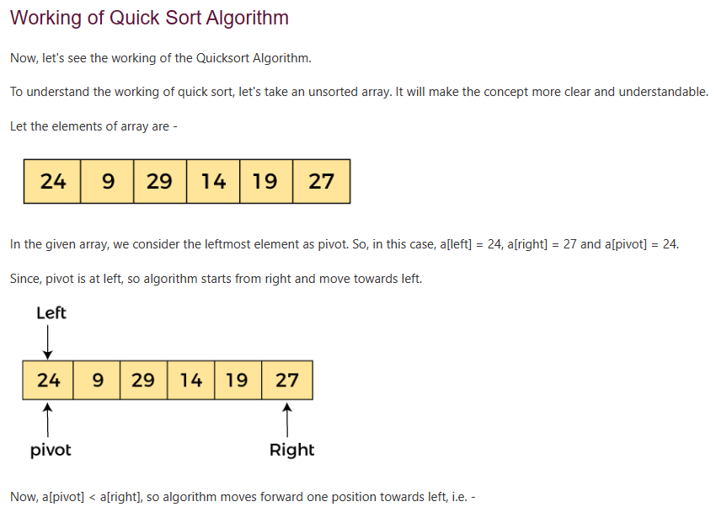

Slide 23
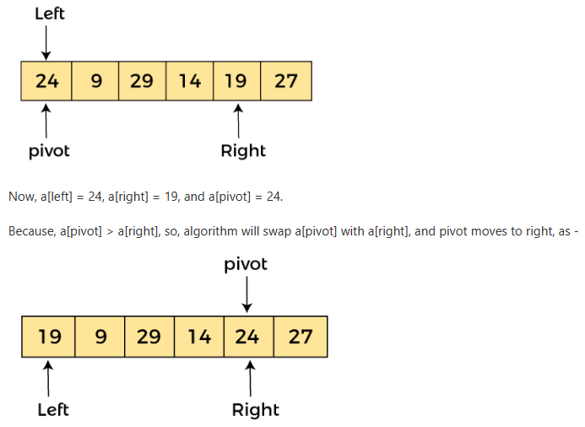

Slide 24
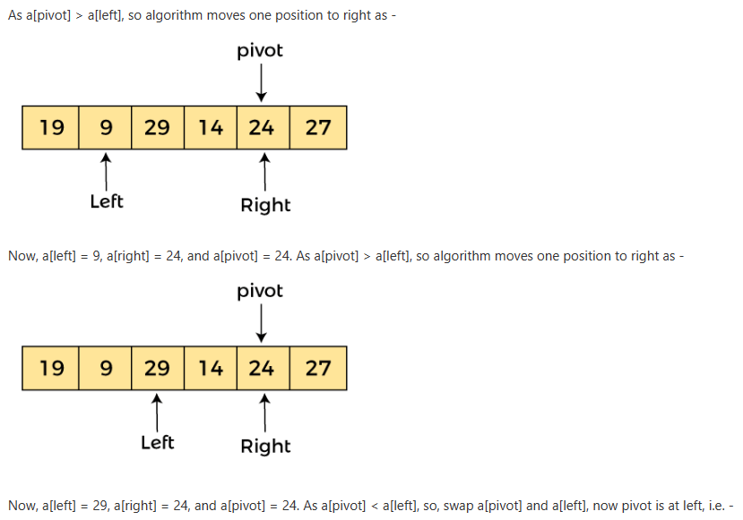

Slide 25
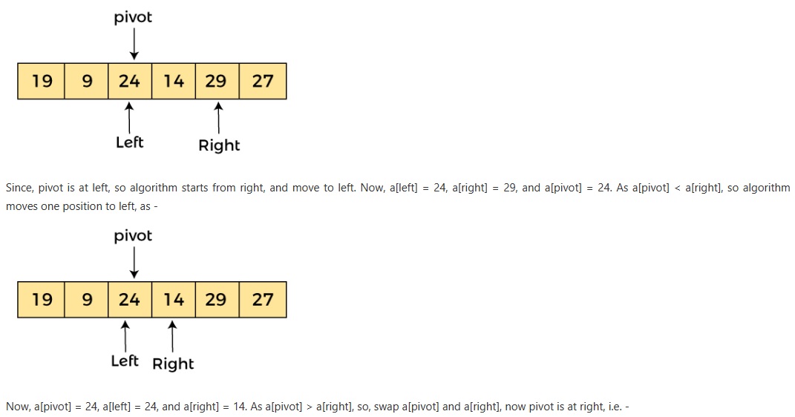

Slide 26
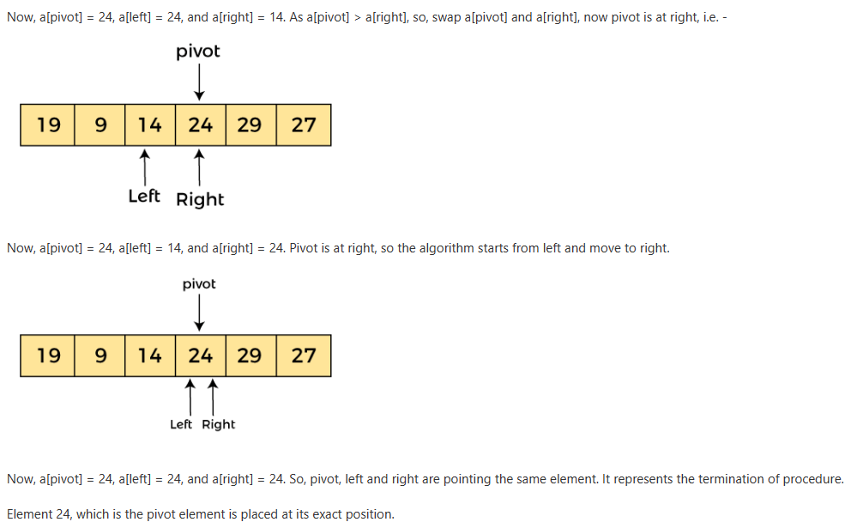

Slide 27
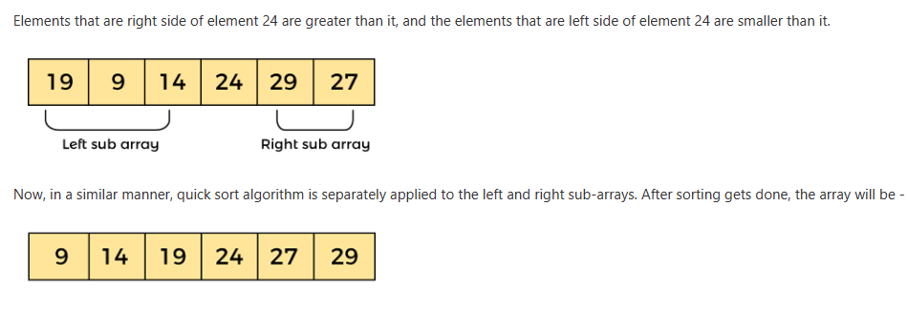

Slide 28
Shell Sort
Shell sort is an algorithm that first sorts the elements far apart from each other and successively reduces the interval between the elements to be sorted.
It is a generalized version of insertion sort.
In shell sort, elements at a specific interval are sorted. The interval between the elements is gradually decreased based on the sequence used.
The performance of the shell sort depends on the type of sequence used for a given input array.

Slide 29
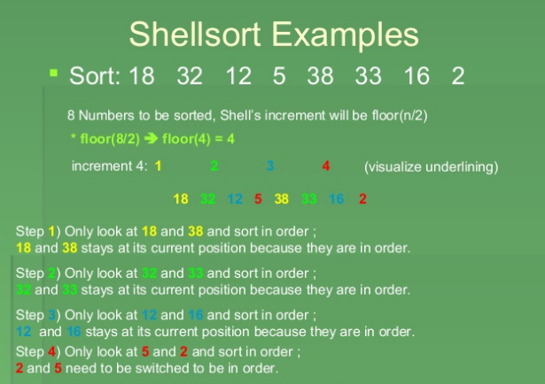
Example

Slide 30
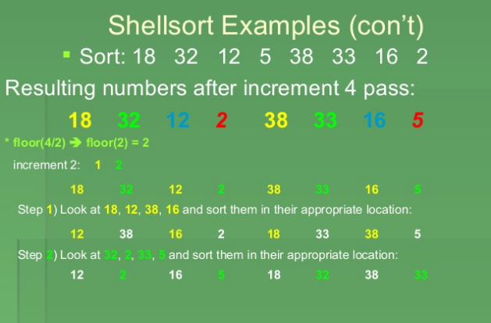
Contd…

Slide 31
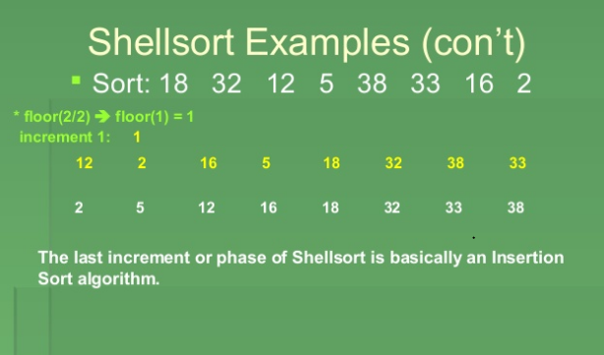
Contd…

Slide 32
Count Sort
In Counting sort, the frequencies of distinct elements of the array to be sorted is counted and stored in an auxiliary array, by mapping its value as an index of the auxiliary array.
Algorithm:
Let's assume that, array A of size N needs to be sorted.
Initialize the auxiliary array Aux[] as 0. Note: The size of this array should be ≥max(A[]).
Traverse array A and store the count of occurrence of each element in the appropriate index of the Aux array, which means, execute Aux[A[i]]++ for each i, where i ranges from [0,N−1].
Initialize the empty array sortedA[]
Traverse array Aux and copy i into sortedA for Aux[i] number of times where 0≤i≤max(A[]).

Slide 33
Count Sort
Example:
Say A={5,2,9,5,2,3,5}.
Aux will be of the size 9+1 i.e. 10
Aux={0,0,2,1,0,3,0,0,0,2}. Notice that Aux[2]=2 which represents the number of occurrences of 2 in A[]. Similarly Aux[5]=3 which represents the number occurrences of 5 in A[].
After applying the counting sort algorithm, sortedA[] will be {2,2,3,5,5,5,9}

Slide 34
HASHING
Hash Table is a data structure where, data is stored in an array format, where each data value has its own unique index value. Access of data becomes very fast if we know the index of the desired data.
Hashing is a technique to convert a range of key values into a range of indexes of an array.
It is a technique that uniquely identifies a specific item from a collection of similar items.

Slide 35
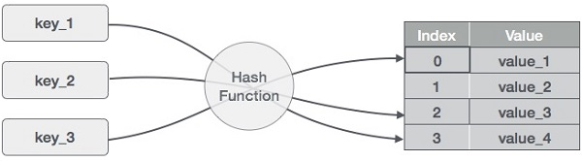
Item are in the (key, value) format
The hash function converts the item into a small integer or hash value. This integer is used as an index to store the original data.
2. It stores the data in a hash table. You can use a hash key to locate data quickly.
hash = hashfunc(key)
index = hash % array_size

Slide 36
Consider an example of hash table of size 20
(1,20)
(2,70)
(42,80)
(4,25)
(12,44)
(14,32)
(17,11)
(13,78)
(37,98)
Sr.No. | Key | Hash | Array Index
1 | 1 | 1 % 20 = 1 | 1
2 | 2 | 2 % 20 = 2 | 2
3 | 42 | 42 % 20 = 2 | 2
4 | 4 | 4 % 20 = 4 | 4
5 | 12 | 12 % 20 = 12 | 12
6 | 14 | 14 % 20 = 14 | 14
7 | 17 | 17 % 20 = 17 | 17
8 | 13 | 13 % 20 = 13 | 13
9 | 37 | 37 % 20 = 17 | 17

Slide 37
Good Hash Function
Efficiently computable.
Should uniformly distribute the keys (Each table position equally likely for each key)

Slide 38
Collision Resolution Technique
Hashing in data structure falls into a collision if two keys are assigned the same index number in the hash table. The collision creates a problem because each index in a hash table is supposed to store only one value.
Hashing in data structure uses several collision resolution techniques to manage the performance of a hash table.
It is a process of finding an alternate location. The collision resolution techniques can be named as-
OPEN HASHING (Chaining)
CLOSE HASHING (open addressing)

Slide 39
Open Hashing
Chaining Method
In chaining, if a hash function produces the same index for multiple elements, these elements are stored in the same index by using a linked list.
Now, we can use a key K to search in the linked list by just linearly traversing. If the intrinsic key for any entry is equal to K then it means that we have found our entry. If we have reached the end of the linked list and yet we haven’t found our entry then it means that the entry does not exist.

Slide 40
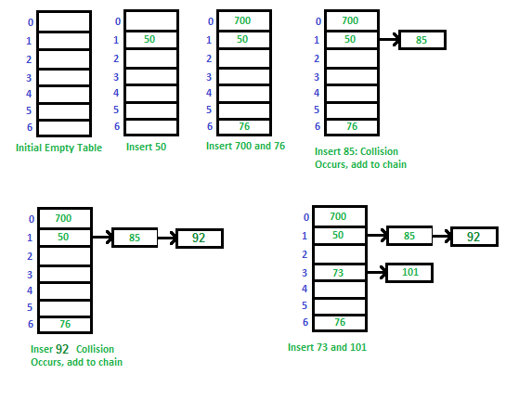
Example: Let us consider a simple hash function as “key mod 7” and a sequence of keys as 50, 700, 76, 85, 92, 73, 101

Slide 41
Close Hashing(Open Addressing)
Linear probing
This hash techniques is known to be the easiest way to resolve any collisions in hash tables.
In linear probing, the hash table is searched sequentially that starts from the original location of the hash. If in case the location that we get is already occupied, then we check for the next location.
The main idea of open addressing is to keep all the data in the same table to achieve it, we search for alternative slots in the hash table until it is found.
Let hash(x) be the slot index computed using a hash function and S be the table size(array_size)
If slot hash(x) % S is full, then we try (hash(x) + 1) % S If (hash(x) + 1) % S is also full, then we try (hash(x) + 2) % S If (hash(x) + 2) % S is also full, then we try (hash(x) + 3) % S …………………………………………..

Slide 42
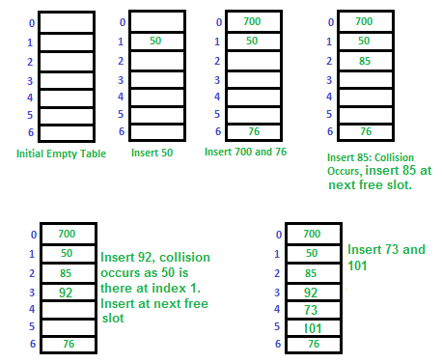
Let us consider a simple hash function as “key mod 7” and a sequence of keys as 50, 700, 76, 85, 92, 73, 101.

Slide 43
Application of Hashing
Message Digest(Cryptographic Hash Function)
Password Verification
File System(to locate files)
Pattern Matching(Detect plagiarism)

Slide 44
Books Recommended
Lipschutz, Seymour, “Data Structures”, Schaum's Outline Series, Tata McGraw Hill.
Gilberg/Forouzan,” Data Structure with C ,Cengage Learning.
Augenstein,Moshe J , Tanenbaum, Aaron M, “Data Structures using C and C++”, Prentice Hall of India.

Slide 45
References
Lipschutz, Seymour, “Data Structures”, Schaum's Outline Series, Tata McGraw Hill.
Goodrich, Michael T., Tamassia, Roberto, and Mount, David M., “Data Structures and Algorithms in C++”, Wiley Student Edition.
“Data Structures and Algorithms for GATE: Solutions to All Previous GATE Questions Since 1991” by Narasimha Karumanchi
https://www3.ntu.edu.sg/home/ehchua/programming/cpp/DataStructureAlgorithm.html
https://www.geeksforgeeks.org/data-structures/
https://www.prodevelopertutorial.com/searching-algorithm-3-jump-search-explanation-and-implementation-in-c-language/
https://www.prodevelopertutorial.com/ajs-guide-to-data-structures-and-algorithms-the-complete-guide-from-beginner-to-expert/

Slide 46

Thank you

